Slide 1
3
Introduction to Classes and Objects

Slide 2
You will see something new. Two things. And I call them Thing One and Thing Two.
  Dr. Theodor Seuss Geisel
Nothing can have value without being an object of utility.
  Karl Marx
Your public servants serve you right.
  Adlai E. Stevenson
Knowing how to answer one who speaks, To reply to one who sends a message.
  Amenemope

Slide 3
OBJECTIVES
In this chapter you will learn:
What classes, objects, member functions and data members are.
How to define a class and use it to create an object.
How to define member functions in a class to implement the class's behaviors.
How to declare data members in a class to implement the class's attributes.
How to call a member function of an object to make that member function perform its task.
The differences between data members of a class and local variables of a function.
How to use a constructor to ensure that an object's data is initialized when the object is created.
How to engineer a class to separate its interface from its implementation and encourage reuse.

Slide 4
3.1 Introduction
3.2 Classes, Objects, Member Functions and Data Members
3.3 Overview of the Chapter Examples
3.4 Defining a Class with a Member Function
3.5 Defining a Member Function with a Parameter
3.6 Data Members, set Functions and get Functions
3.7 Initializing Objects with Constructors
3.8 Placing a Class in a Separate File for Reusability
3.9 Separating Interface from Implementation
3.10 Validating Data with set Functions
3.11 (Optional) Software Engineering Case Study: Identifying the Classes in the ATM Requirements Document
3.12 Wrap-Up

Slide 5
3.1 Introduction
Programs from Chapter 2
  All statements were located in function main
Typically
  Programs will consist of
    Function main and
    One or more classes
      Each containing data members and member functions

Slide 6
3.2 Classes, Objects, Member Functions and Data Members
Review of classes: Car example
  Functions describe the mechanisms that perform a tasks, such as acceleration
    Hides complex tasks from user, just as a driver can use the pedal to accelerate without needing to know how the acceleration is performed
  Classes must be defined before they can be used, car must be built before it can be driven
  Many car objects created from same class, many cars built from same engineering drawing

Slide 7
3.2 Classes, Objects, Member Functions and Data Members (Cont.)
Review of classes: Car example (Cont.)
  Member-function calls send messages to an object to perform tasks, just like pressing the gas pedal sends a message to the car to accelerate
  Objects and cars both have attributes, like color and miles driven

Slide 8
3.3 Overview of the Chapter Examples
Seven simple examples
  Examples used to build a GradeBook class
Topics covered:
  Member functions
  Data members
  Clients of a class
    Other classes or functions that call the member functions of this class’s objects
  Separating interface from implementation
  Data validation
    Ensures that data in an object is in a particular format or range

Slide 9
3.4 Defining a Class With a Member Function
Class definition
  Tells compiler what member functions and data members belong to the class
  Keyword class followed by the class’s name
  Class body is enclosed in braces ({})
    Specifies data members and member functions
    Access-specifier public:
      Indicates that a member function or data member is accessible to other functions and member functions of other classes

Slide 10
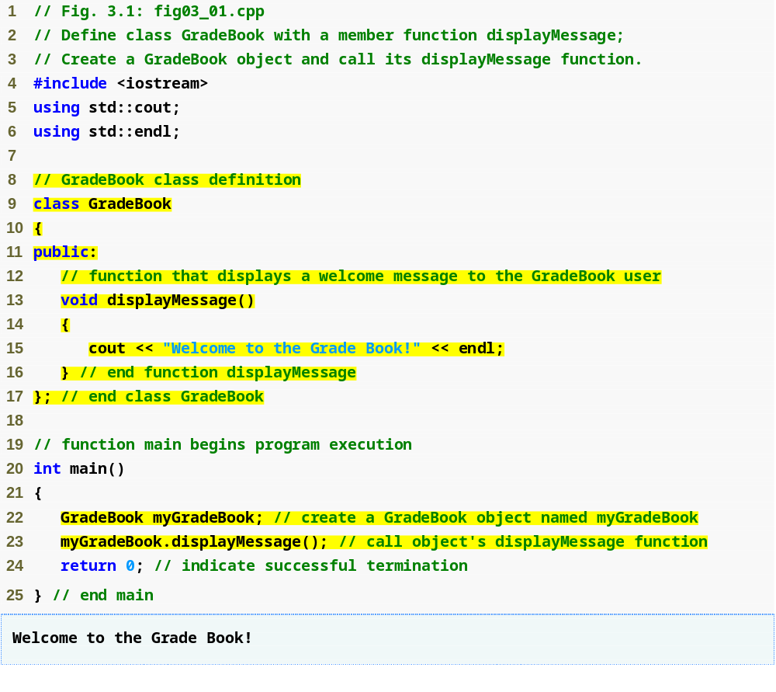
Outline
fig03_01.cpp
(1 of 1)
Beginning of class definition for class GradeBook
Beginning of class body
Access specifier public; makes members available to the public
Member function displayMessge returns nothing
End of class body
Use dot operator to call GradeBook’s member function

Slide 11
Common Programming Error 3.1
Forgetting the semicolon at the end of a class definition is a syntax error.

Slide 12
3.4 Defining a Class With a Member Function (Cont.)
Member function definition
  Return type of a function
    Indicates the type of value returned by the function when it completes its task
    void indicates that the function does not return any value
  Function names must be a valid identifier
  Parentheses after function name indicate that it is a function
  Function body contains statements that perform the function’s task
    Delimited by braces ({})

Slide 13
Common Programming Error 3.2
Returning a value from a function whose return type has been declared void is a compilation error.

Slide 14
Common Programming Error 3.3
Defining a function inside another function is a syntax error.

Slide 15
3.4 Defining a Class With a Member Function (Cont.)
Using a class
  A class is a user-defined type (or programmer-defined type)
    Can be used to create objects
      Variables of the class type
    C++ is an extensible language
  Dot operator (.)
    Used to access an object’s data members and member functions
    Example
      myGradeBook.displayMessage()
        Call member function displayMessage of GradeBook object myGradeBook

Slide 16

Fig.3.2 | UML class diagram indicating that class GradeBook has a public displayMessage operation.

Slide 17
3.4 Defining a Class With a Member Function (Cont.)
UML class diagram
  A rectangle with three compartments
    Top compartment contains the name of the class
    Middle compartment contains the class’s attributes
    Bottom compartment contains the class’s operations
      A (+) in front of an operation indicates it is public

Slide 18
3.5 Defining a Member Function with a Parameter
Function parameter(s)
  Information needed by a function to perform its task
Function argument(s)
  Values supplied by a function call for each of the function’s parameters
    Argument values are copied into function parameters

Slide 19
3.5 Defining a Member Function with a Parameter (Cont.)
A string
  Represents a string of characters
  An object of C++ Standard Library class std::string
    Defined in header file <string>
Library function getline
  Used to retrieve input until newline is encountered
  Example
    getline( cin, nameOfCourse );
      Inputs a line from standard input into string object nameOfCourse

Slide 20
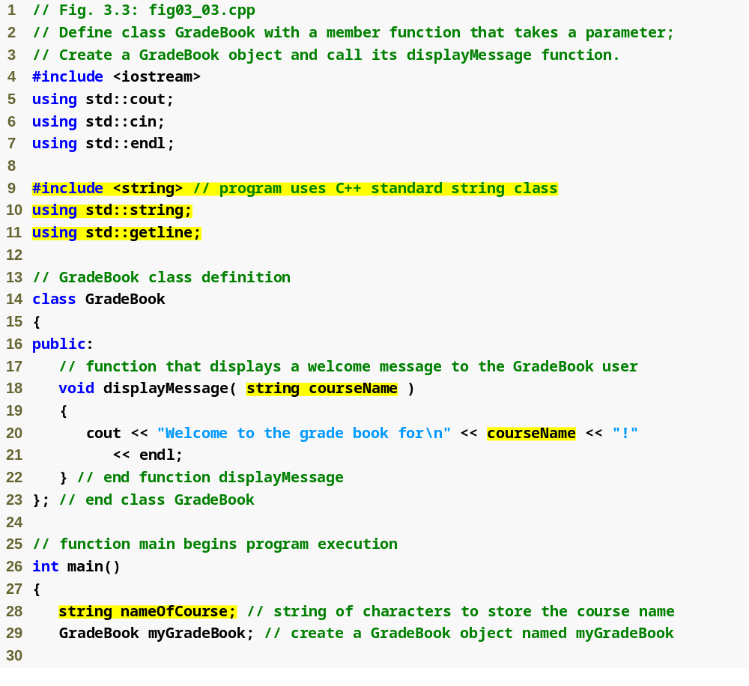
Outline
Include string class definition
fig03_03.cpp
(1 of 2)
Member function parameter
Use the function parameter as a variable

Slide 21
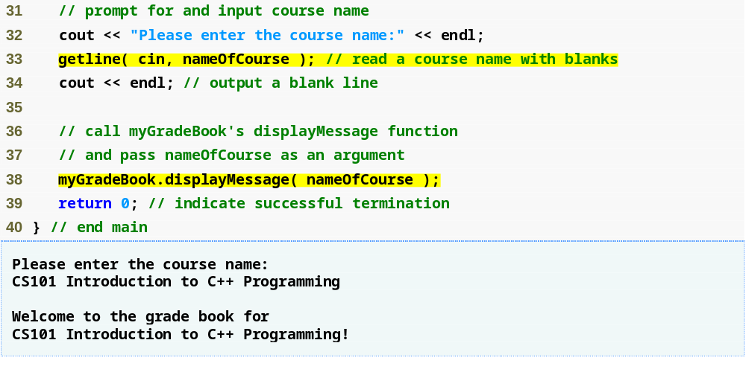
Outline
fig03_03.cpp
(2 of 2)
Passing an argument to the member function

Slide 22
3.5 Defining a Member Function with a Parameter (Cont.)
Parameter Lists
  Additional information needed by a function
  Located in parentheses following the function name
  Function may have any number of parameters
    Parameters separated by commas
  Number, order and types of arguments in a function call must match the number, order and types of parameters in the called function’s parameter list
  Modeled in UML
    Parameter name, followed by a colon and the parameter type in the member function’s parentheses

Slide 23
Common Programming Error 3.4
4Placing a semicolon after the right parenthesis enclosing the parameter list of a function definition is a syntax error.

Slide 24
Common Programming Error 3.5
Defining a function parameter again as a local variable in the function is a compilation error.

Slide 25
Good Programming Practice 3.1
To avoid ambiguity, do not use the same names for the arguments passed to a function and the corresponding parameters in the function definition.

Slide 26
Good Programming Practice 3.2
Choosing meaningful function names and meaningful parameter names makes programs more readable and helps avoid excessive use of comments.

Slide 27

Fig.3.4 | UML class diagram indicating that class GradeBook has a displayMessage operation with a courseName parameter of UML type String.

Slide 28
3.6 Data Members, set Functions and get Functions
Local variables
  Variables declared in a function definition’s body
    Cannot be used outside of that function body
  When a function terminates
    The values of its local variables are lost
Attributes
  Exist throughout the life of the object
  Represented as data members
    Variables in a class definition
  Each object of class maintains its own copy of attributes

Slide 29
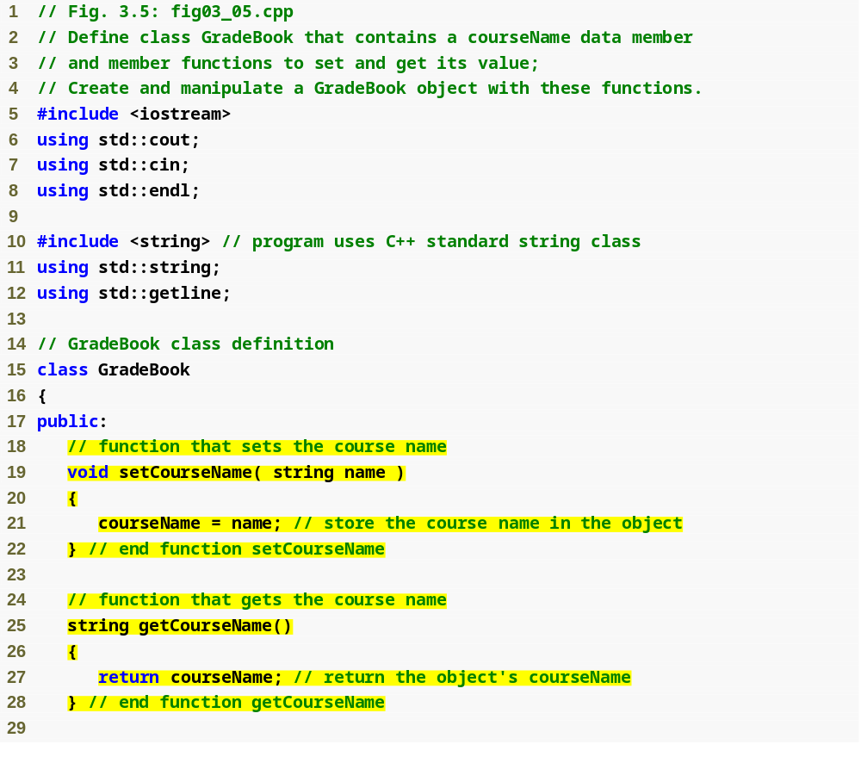
Outline
fig03_05.cpp
(1 of 3)
set function modifies private data
get function accesses private data

Slide 30
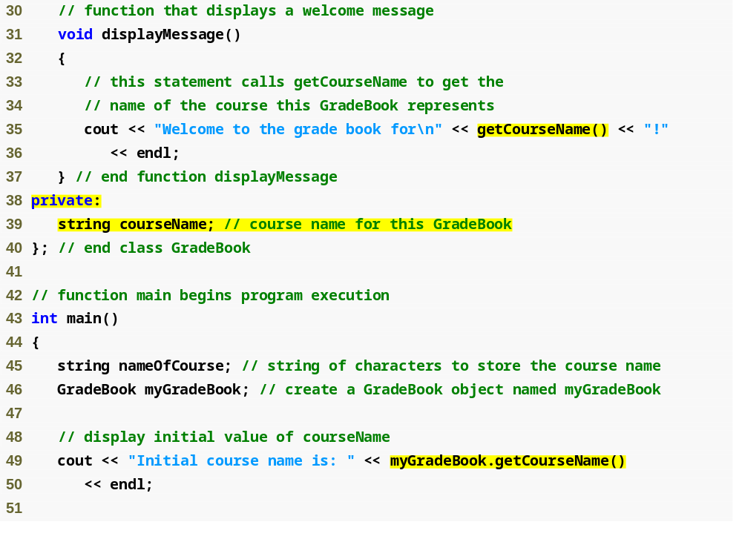
Outline
fig03_05.cpp
(2 of 3)
Use set and get functions, even within the class
private members accessible only to member functions of the class
Accessing private data outside class definition

Slide 31
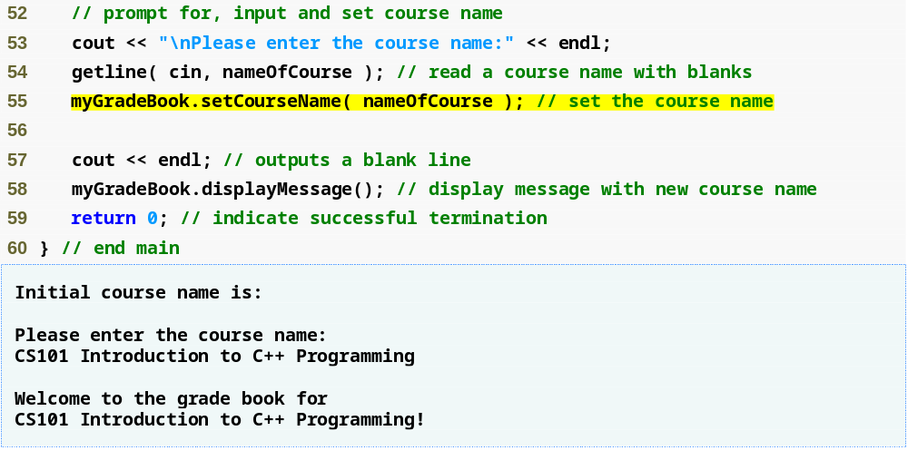
Outline
fig03_05.cpp
(3 of 3)
Modifying private data outside class definition

Slide 32
Good Programming Practice 3.3
Place a blank line between member-function definitions to enhance program readability.

Slide 33
3.6 Data Members, set Functions and get Functions (Cont.)
Access-specifier private
  Makes a data member or member function accessible only to member functions of the class
  private is the default access for class members
  Data hiding
Returning a value from a function
  A function that specifies a return type other than void
    Returns a value to its calling function

Slide 34
Software Engineering Observation 3.1
As a rule of thumb, data members should be declared private and member functions should be declared public. (We will see that it is appropriate to declare certain member functions private, if they are to be accessed only by other member functions of the class.)

Slide 35
Common Programming Error 3.6
An attempt by a function, which is not a member of a particular class (or a friend of that class, as we will see in Chapter 10), to access a private member of that class is a compilation error.

Slide 36
Good Programming Practice 3.4
Despite the fact that the public and private access specifiers may be repeated and intermixed, list all the public members of a class first in one group and then list all the private mem­bers in another group. This focuses the client’s attention on the class’s public interface, rather than on the class’s implementation.

Slide 37
Good Programming Practice 3.5
If you choose to list the private members first in a class definition, explicitly use the private access specifier despite the fact that private is assumed by default. This improves program clarity.

Slide 38
Software Engineering Observation 3.2
We will learn in Chapter 10, Classes: Part 2, that functions and classes declared by a class to be friends can access the private members of the class.

Slide 39
Error-Prevention Tip 3.1
Making the data members of a class private and the member functions of the class public facilitates debugging because problems with data manipulations are localized to either the class’s member functions or the friends of the class.

Slide 40
Common Programming Error 3.7
Forgetting to return a value from a function that is supposed to return a value is a compilation error.

Slide 41
3.6 Data Members, set Functions and get Functions (Cont.)
Software engineering with set and get functions
  public member functions that allow clients of a class to set or get the values of private data members
  set functions sometimes called mutators and get functions sometimes called accessors
  Allows the creator of the class to control how clients access private data
  Should also be used by other member functions of the same class

Slide 42
Good Programming Practice 3.6
Always try to localize the effects of changes to a class’s data members by accessing and manipulating the data members through their get and set functions. Changes to the name of a data member or the data type used to store a data member then affect only the corresponding get and set functions, but not the callers of those functions.

Slide 43
Software Engineering Observation 3.3
It is important to write programs that are understandable and easy to maintain. Change is the rule rather than the exception. Programmers should anticipate that their code will be modified.

Slide 44
Software Engineering Observation 3.4
The class designer need not provide set or get functions for each private data item; these capabilities should be provided only when appropriate. If a service is useful to the client code, that service should typically be provided in the class’s public interface.

Slide 45
3.6 Data Members, set Functions and get Functions (Cont.)
UML diagram
  Indicating the return type of an operation
    Place a colon and the return type after the parentheses following the operation name
  Minus sign used to indicate private members

Slide 46

Fig.3.6 | UML class diagram for class GradeBook with a private courseName attribute and public operations setCourseName, getCourseName and displayMessage.

Slide 47
3.7 Initializing Objects with Constructors
Constructors
  Functions used to initialize an object’s data when it is created
    Call made implicitly when object is created
    Must be defined with the same name as the class
    Cannot return values
      Not even void
  Default constructor has no parameters
    The compiler will provide one when a class does not explicitly include a constructor
      Compiler’s default constructor only calls constructors of data members that are objects of classes

Slide 48
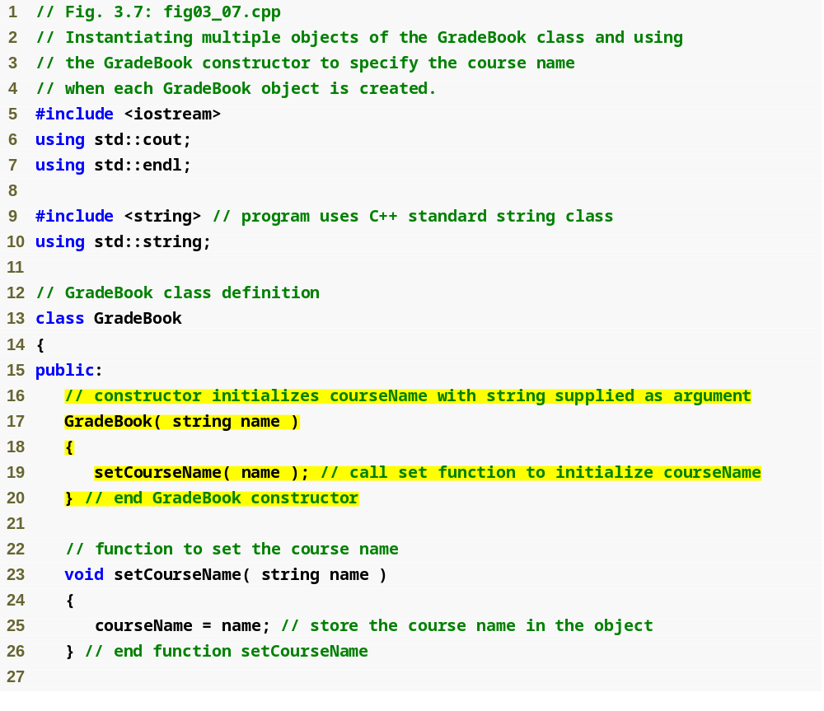
Outline
fig03_07.cpp
(1 of 3)
Constructor has same name as class and no return type
Initialize data member

Slide 49
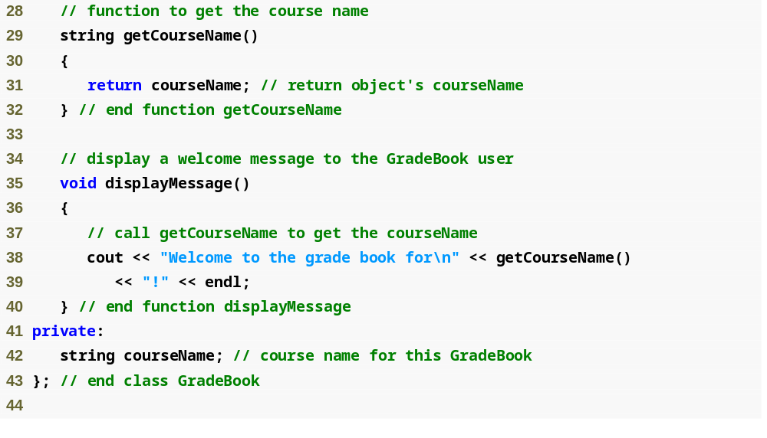
Outline
fig03_07.cpp
(2 of 3)

Slide 50
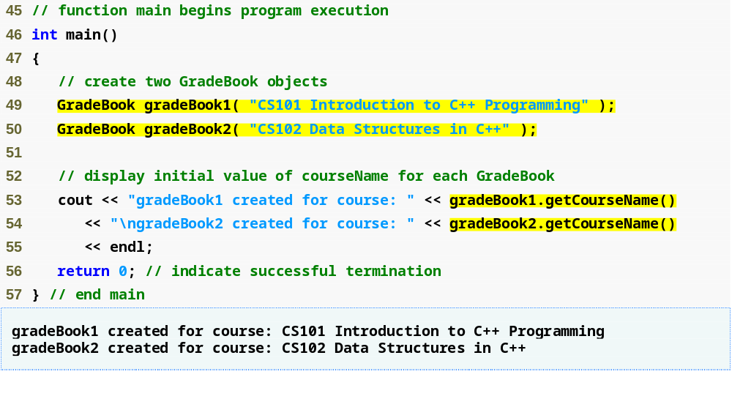
Outline
fig03_07.cpp
(3 of 3)
Creating objects implicitly calls the constructor

Slide 51
Error-Prevention Tip 3.2
Unless no initialization of your class’s data members is necessary (almost never), provide a constructor to ensure that your class’s data members are initialized with meaningful values when each new object of your class is created.

Slide 52
Software Engineering Observation 3.5
Data members can be initialized in a constructor of the class or their values may be set later after the object is created. However, it is a good software engineering practice to ensure that an object is fully initialized before the client code invokes the object’s member functions. In general, you should not rely on the client code to ensure that an object gets initialized properly.

Slide 53
3.7 Initializing Objects with Constructors (Cont.)
Constructors in a UML class diagram
  Appear in third compartment, with operations
  To distinguish a constructor from a class’s operations
    UML places the word “constructor” between guillemets before the constructor’s name
      <<constructor>>
  Usually placed before other operations

Slide 54

Fig.3.8 | UML class diagram indicating that class GradeBook has a constructor with a name parameter of UML type String.

Slide 55
3.8 Placing a Class in a Separate File for Reusability
.cpp file is known as a source-code file
Header files
  Separate files in which class definitions are placed
    Allow compiler to recognize the classes when used elsewhere
  Generally have .h filename extensions
Driver files
  Program used to test software (such as classes)
  Contains a main function so it can be executed

Slide 56
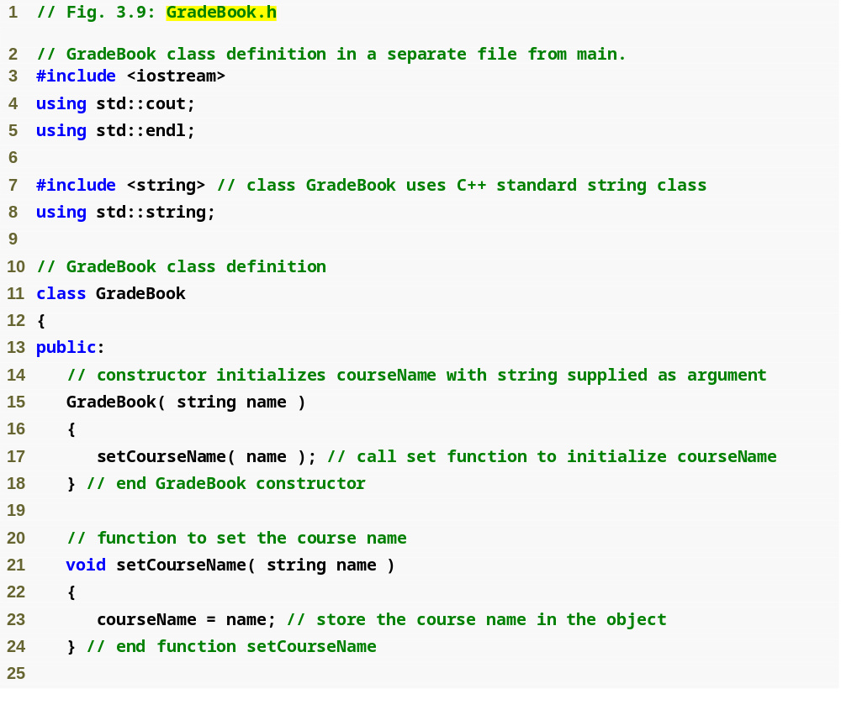
Outline
Class definition is in a header file
fig03_09.cpp
(1 of 2)

Slide 57
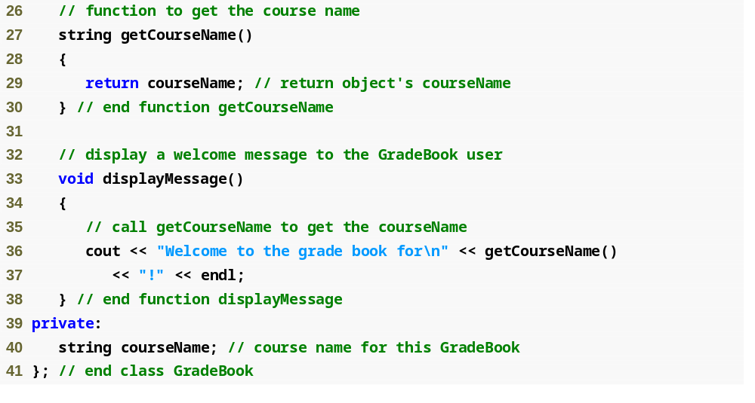
Outline
fig03_09.cpp
(2 of 2)

Slide 58
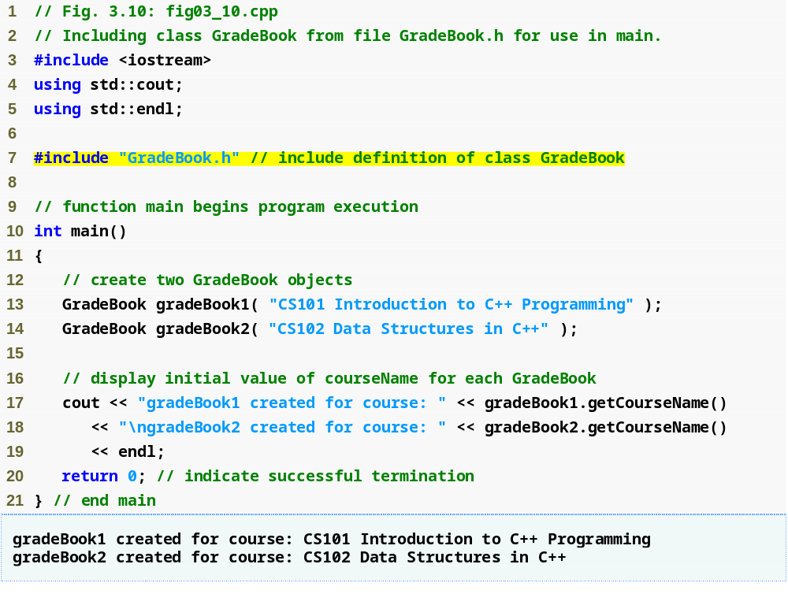
Outline
fig03_10.cpp
(1 of 1)
Including the header file causes the class definition to be copied into the file

Slide 59
3.8 Placing a Class in a Separate File for Reusability (Cont.)
#include preprocessor directive
  Used to include header files
    Instructs C++ preprocessor to replace directive with a copy of the contents of the specified file
  Quotes indicate user-defined header files
    Preprocessor first looks in current directory
      If the file is not found, looks in C++ Standard Library directory
  Angle brackets indicate C++ Standard Library
    Preprocessor looks only in C++ Standard Library directory

Slide 60
3.8 Placing a Class in a Separate File for Reusability (Cont.)
Creating objects
  Compiler must know size of object
    C++ objects typically contain only data members
    Compiler creates one copy of class’s member functions
      This copy is shared among all the class’s objects

Slide 61
Error-Prevention Tip 3.3
To ensure that the preprocessor can locate header files correctly, #include preprocessor directives should place the names of user-defined header files in quotes (e.g., "GradeBook.h") and place the names of C++ Standard Library header files in angle brackets (e.g., <iostream>).

Slide 62
3.9 Separating Interface from Implementation
Interface
  Describes what services a class’s clients can use and how to request those services
    But does not reveal how the class carries out the services
    A class definition that lists only member function names, return types and parameter types
      Function prototypes
  A class’s interface consists of the class’s public member functions (services)
Separating interface from implementation
  Client code should not break if implementation changes, as long as interface stays the same

Slide 63
3.9 Separating Interface from Implementation (Cont.)
Separating interface from implementation (Cont.)
  Define member functions outside the class definition, in a separate source-code file
    In source-code file for a class
      Use binary scope resolution operator (::) to tie each member function to the class definition
    Implementation details are hidden
      Client code does not need to know the implementation
  In header file for a class
    Function prototypes describe the class’s public interface

Slide 64
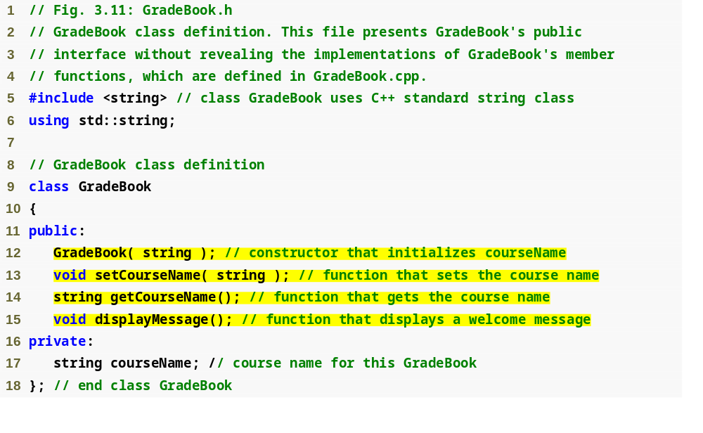
Outline
fig03_11.cpp
(1 of 1)
Interface contains data members and member function prototypes

Slide 65
Common Programming Error 3.8
Forgetting the semicolon at the end of a function prototype is a syntax error.

Slide 66
Good Programming Practice 3.7
Although parameter names in function prototypes are optional (they are ignored by the compiler), many programmers use these names for documentation purposes.

Slide 67
Error-Prevention Tip 3.4
Parameter names in a function prototype (which, again, are ignored by the compiler) can be misleading if wrong or confusing names are used. For this reason, many programmers create function prototypes by copying the first line of the corresponding function definitions (when the source code for the functions is available), then appending a semicolon to the end of each prototype.

Slide 68
Common Programming Error 3.9
When defining a class’s member functions outside that class, omitting the class name and binary scope resolution operator (::) preceding the function names causes compilation errors.

Slide 69
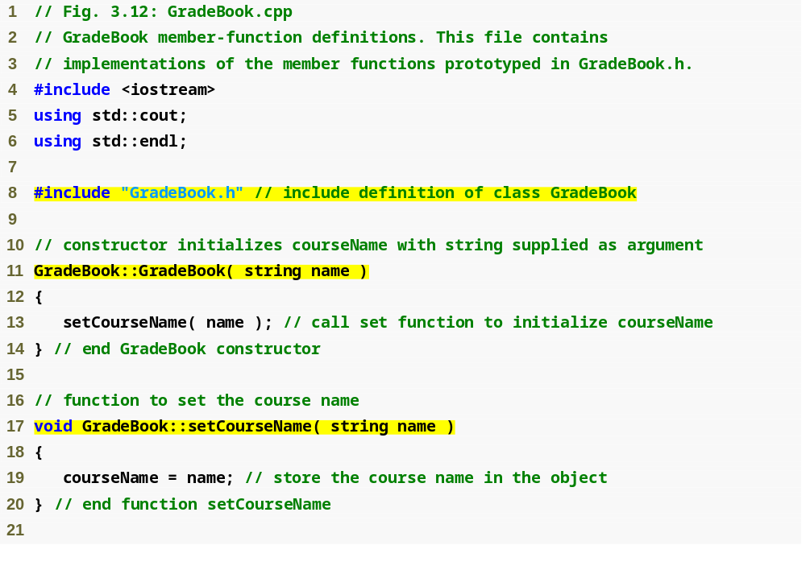
Outline
GradeBook implementation is placed in a separate source-code file
fig03_12.cpp
(1 of 2)
Include the header file to access the class name GradeBook
Binary scope resolution operator ties a function to its class

Slide 70
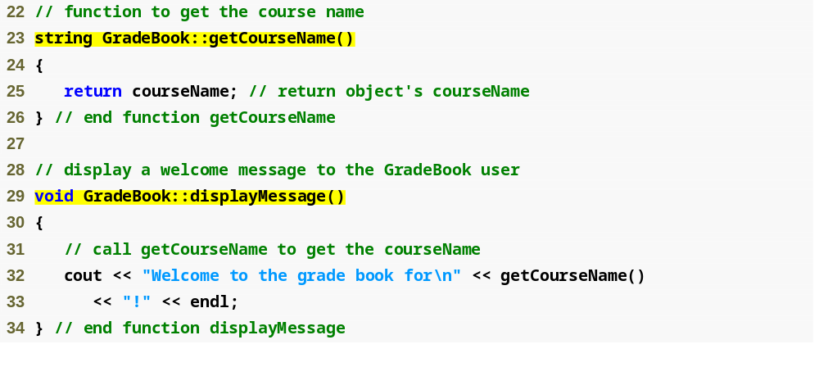
Outline
fig03_12.cpp
(2 of 2)

Slide 71
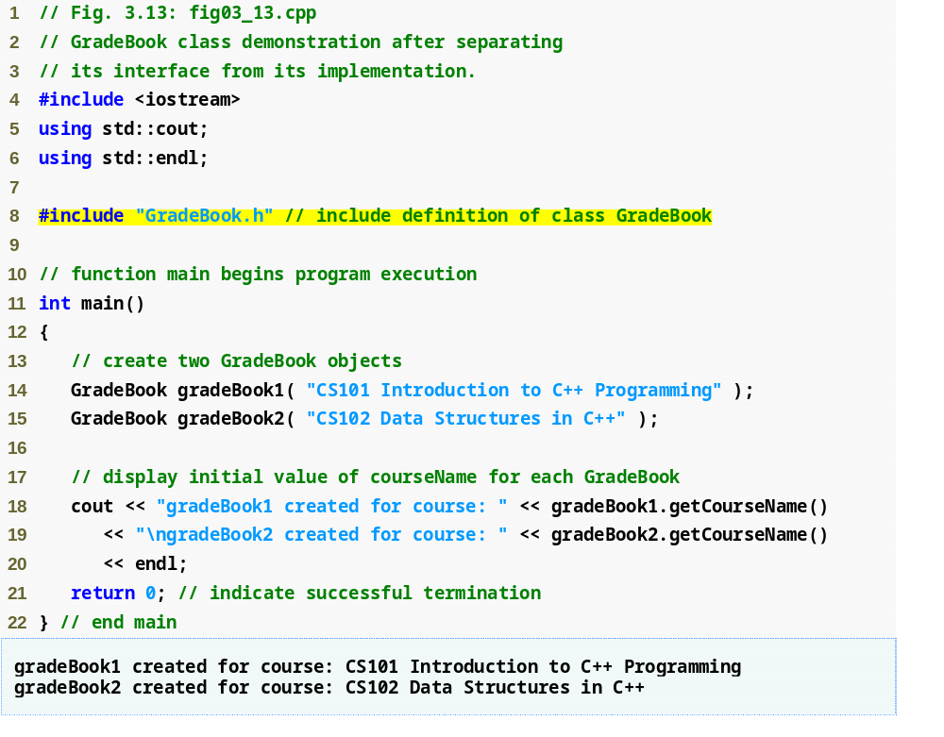
Outline
fig03_13.cpp
(1 of 1)

Slide 72
3.9 Separating Interface from Implementation (Cont.)
The Compilation and Linking Process
  Source-code file is compiled to create the class’s object code (source-code file must #include header file)
    Class implementation programmer only needs to provide header file and object code to client
  Client must #include header file in their own code
    So compiler can ensure that the main function creates and manipulates objects of the class correctly
  To create executable application
    Object code for client code must be linked with the object code for the class and the object code for any C++ Standard Library object code used in the application

Slide 73
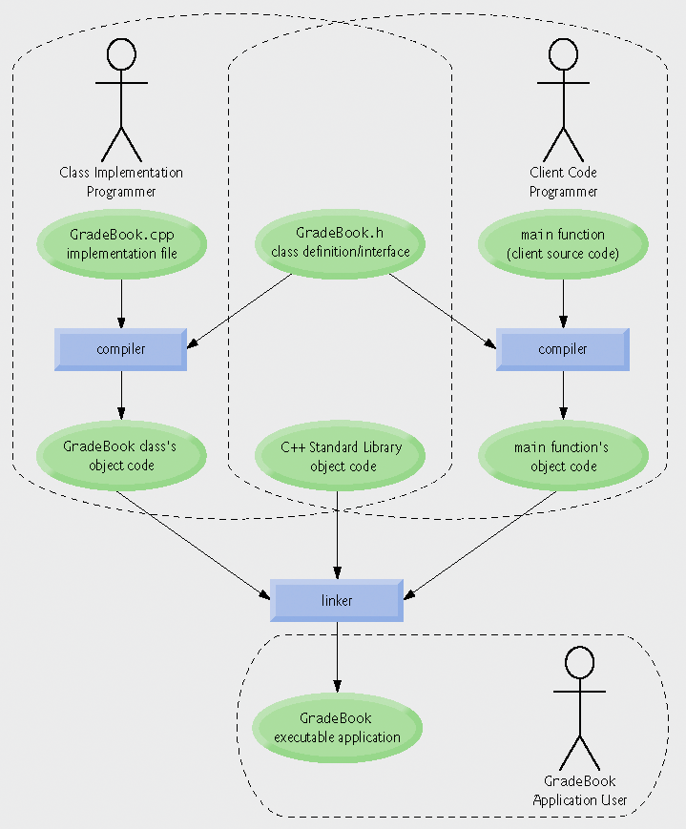
Fig.3.14 | Compilation and linking process that produces an executable application.

Slide 74
3.10 Validating Data with set Functions
set functions can validate data
  Known as validity checking
  Keeps object in a consistent state
    The data member contains a valid value
  Can return values indicating that attempts were made to assign invalid data
string member functions
  length returns the number of characters in the string
  Substr returns specified substring within the string

Slide 75
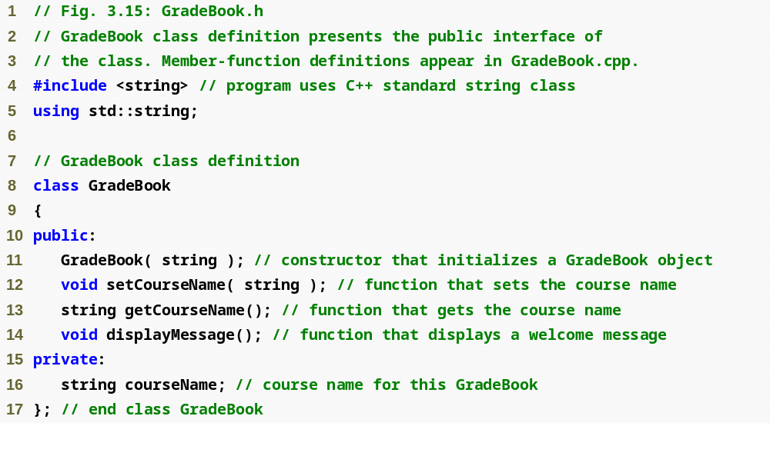
Outline
fig03_15.cpp
(1 of 1)

Slide 76
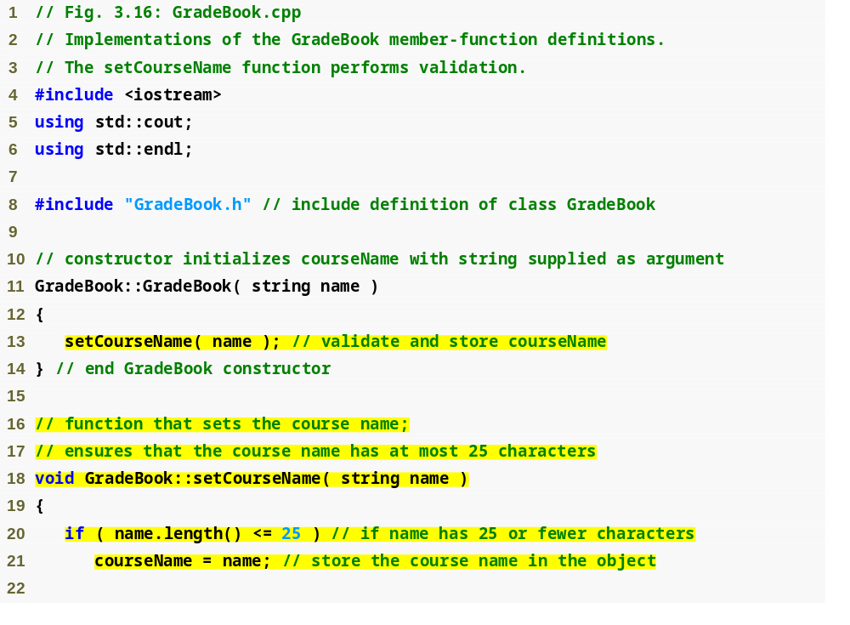
Outline
fig03_16.cpp
(1 of 2)
Constructor calls set function to perform validity checking
set functions perform validity checking to keep courseName in a consistent state

Slide 77
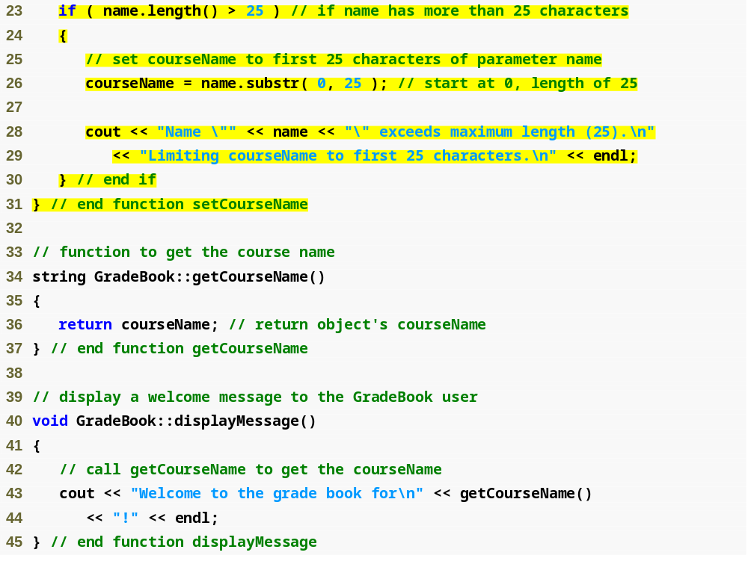
Outline
fig03_16.cpp
(2 of 2)

Slide 78
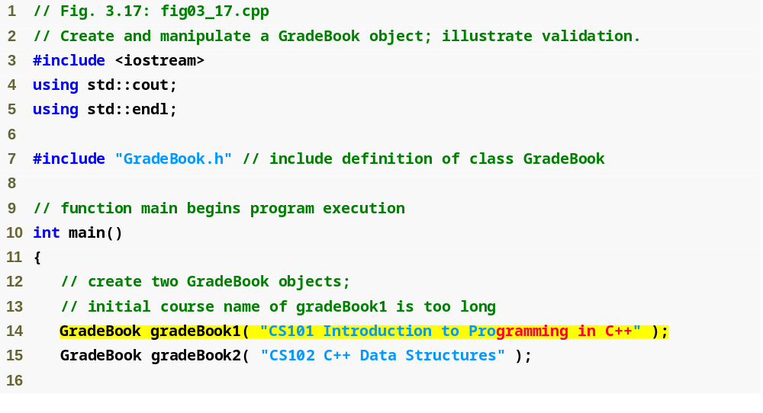
Outline
fig03_17.cpp
(1 of 2)
Constructor will call set function to perform validity checking

Slide 79
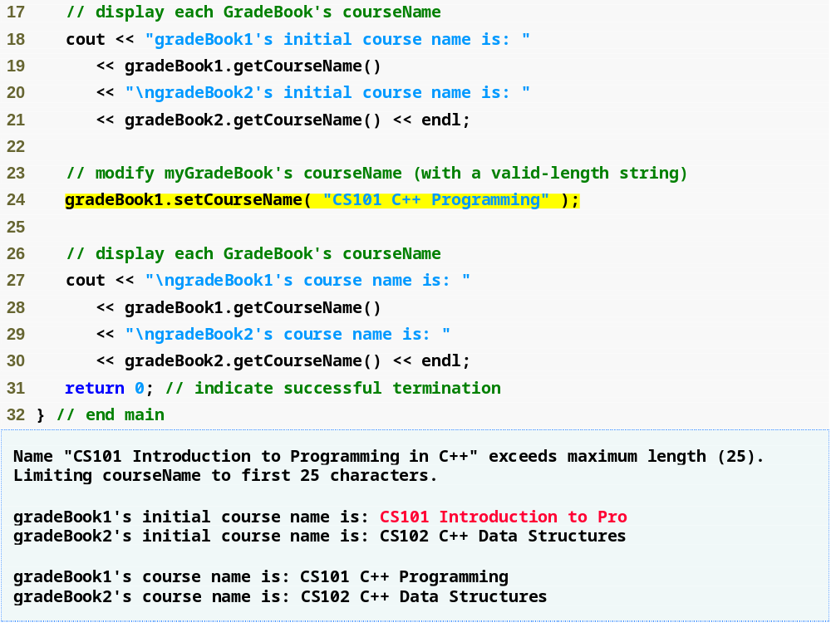
Outline
fig03_17.cpp
(2 of 2)
Call set function to perform validity checking

Slide 80
Software Engineering Observation 3.6
Making data members private and controlling access, especially write access, to those data members through public member functions helps ensure data integrity.

Slide 81
Error-Prevention Tip 3.5
The benefits of data integrity are not automatic simply because data members are made private—the programmer must provide appropriate validity checking and report the errors.

Slide 82
Software Engineering Observation 3.7
Member functions that set the values of private data should verify that the intended new values are proper; if they are not, the set functions should place the private data members into an appropriate state.

Slide 83
3.11 (Optional) Software Engineering Case Study: Identifying the Classes in the ATM Requirements Document
Identifying the classes in a system
  Key nouns and noun phrases in requirements document
    Some are attributes of other classes
    Some do not correspond to parts of the system
    Some are classes
      To be represented by UML class diagrams

Slide 84
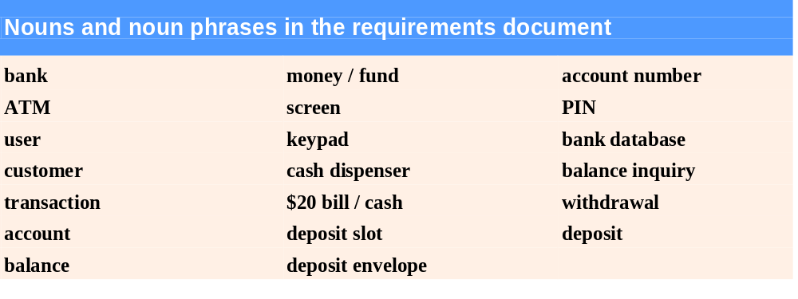
Fig.3.18 | Nouns and noun phrases in the requirements document.

Slide 85
3.11 (Optional) Software Engineering Case Study: Identifying the Classes in the ATM Requirements Document (Cont.)
Modeling classes with UML class diagrams
  Top compartment contains name of the class
  Middle compartment contains attributes
  Bottom compartment contains operations
  An elided diagram
    Suppress some class attributes and operations for readability
  An association
    Represented by a solid line that connects two classes
    Association can be named
    Numbers near end of each line are multiplicity values
    Role name identifies the role an object plays in an association

Slide 86

Fig.3.19 | Representing a class in the UML using a class diagram.

Slide 87
Fig.3.20 | Class diagram showing an association among classes.

Slide 88
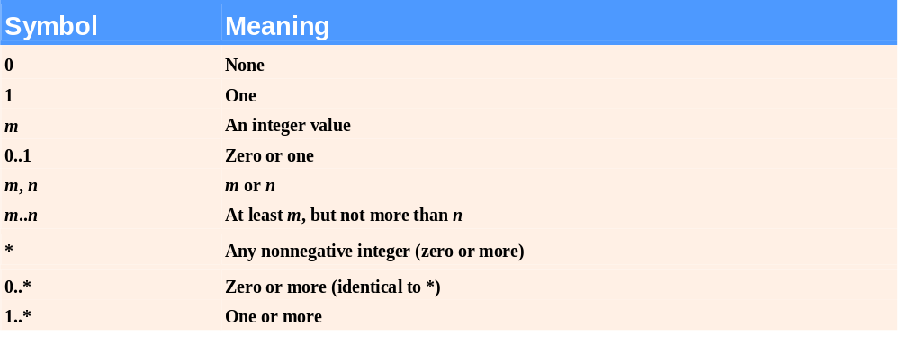
Fig.3.21 | Multiplicity types.

Slide 89
3.11 (Optional) Software Engineering Case Study: Identifying the Classes in the ATM Requirements Document (Cont.)
Composition relationship
  Indicated by solid diamonds attached to association lines
  Composition properties
    Only one class can represent the whole
    Parts only exist while whole exists, whole creates and destroys parts
    A part may only belong to one whole at a time
Hollow diamonds indicate aggregation
  A weaker form of composition
Types of associations
  One-to-one
  One-to-many
  Many-to-one

Slide 90
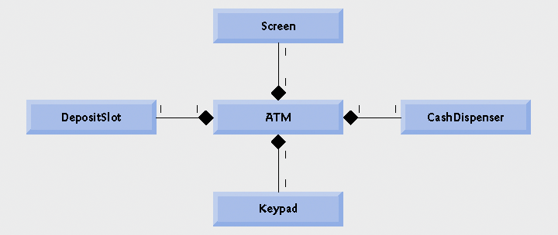
Fig.3.22 | Class diagram showing composition relationships.

Slide 91
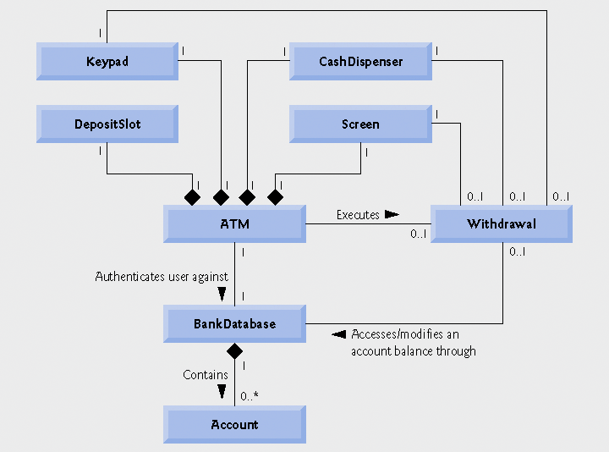
Fig.3.23 | Class diagram for the ATM system model

Slide 92
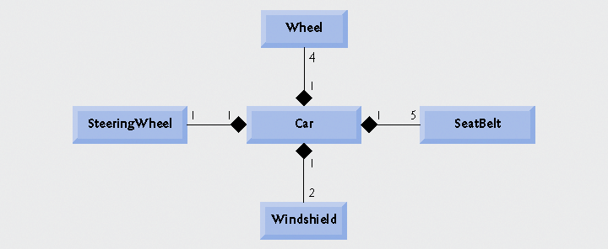
Fig.3.24 | Class diagram showing composition relationships of a class Car.

Slide 93
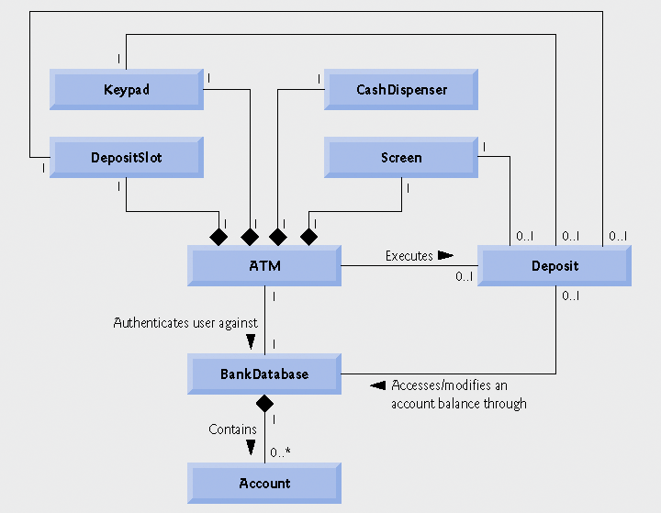
Fig.3.25 | Class diagram for the ATM system model including class Deposit.

